Slide 1
Extern keyword C++
By Kyle Nuttall

Slide 2
What is the use of extern?
Using the extern keyword when declaring a variable means variable is defined externally (in another file or translation unit). Extern variables are generally global variables that can be used across other translation units during linkage.

Slide 3
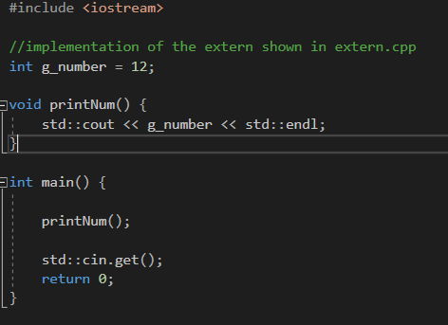
Example
main.cpp
extern.cpp

